Slide 1
UK Energy Market Update
October 2023

Slide 2
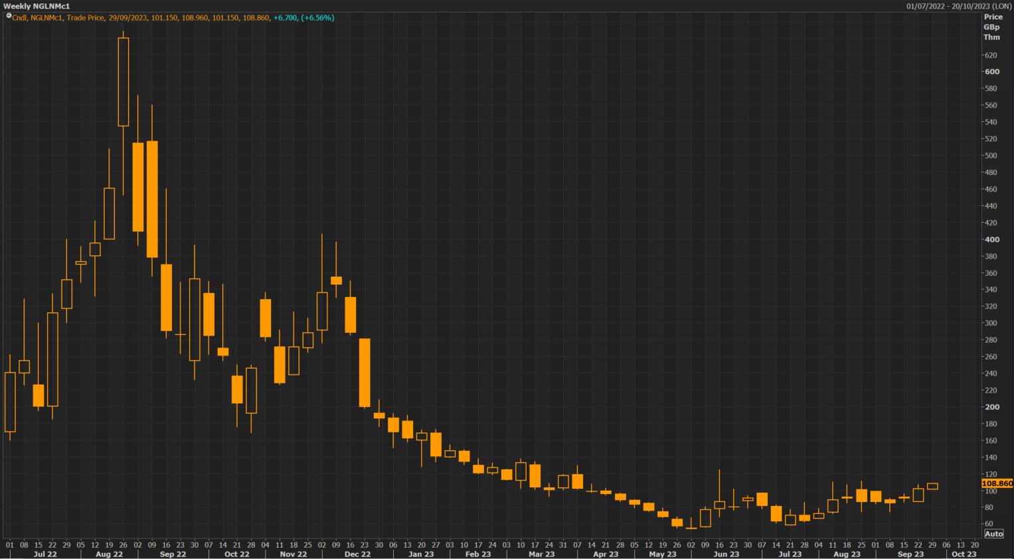
GAS & POWER MARKET UPDATE:
Summer gas delivered just below 90ppt, power just below £95/MWh
European gas storage is nearly full, and may even reach “tank tops” during October
French nuclear output has improved and is giving continental power market more confidence
Russian piped gas still flowing, as is Russian LNG
Generally healthy global LNG balance, despite Aussie strike threat. Europe priced below Asia…
El Nino declared
Winter is coming
Front month gas price (weekly)
Source: Refinitiv
Market is sufficient supplies and has been pricing to push LNG east

Slide 3
European gas storage inventories
Source: Refinitiv (*only Belgium, Netherlands, France and Germany shown here)
Healthy European gas inventories

Slide 4
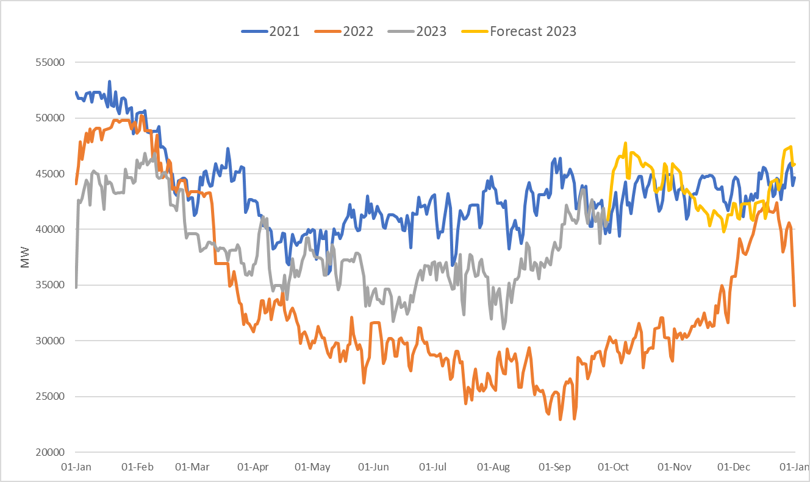
Nuclear generation in France
Source: Refinitiv
Output in France better than last year

Slide 5
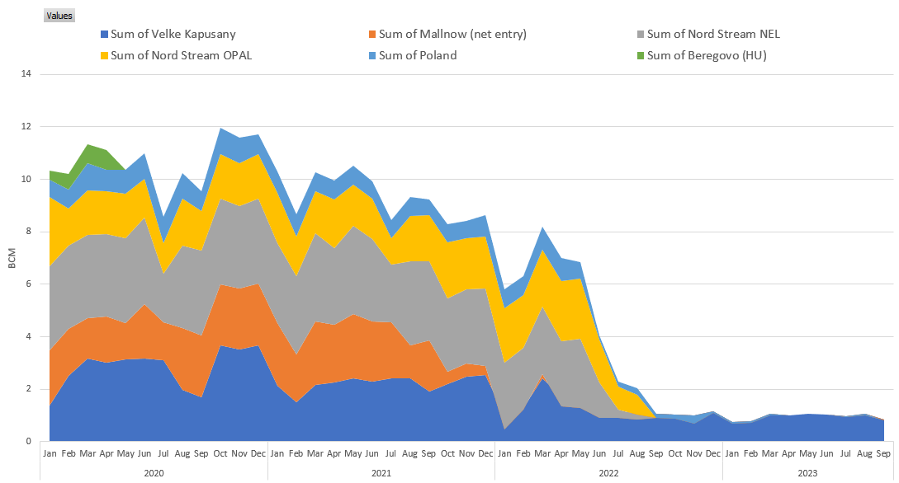
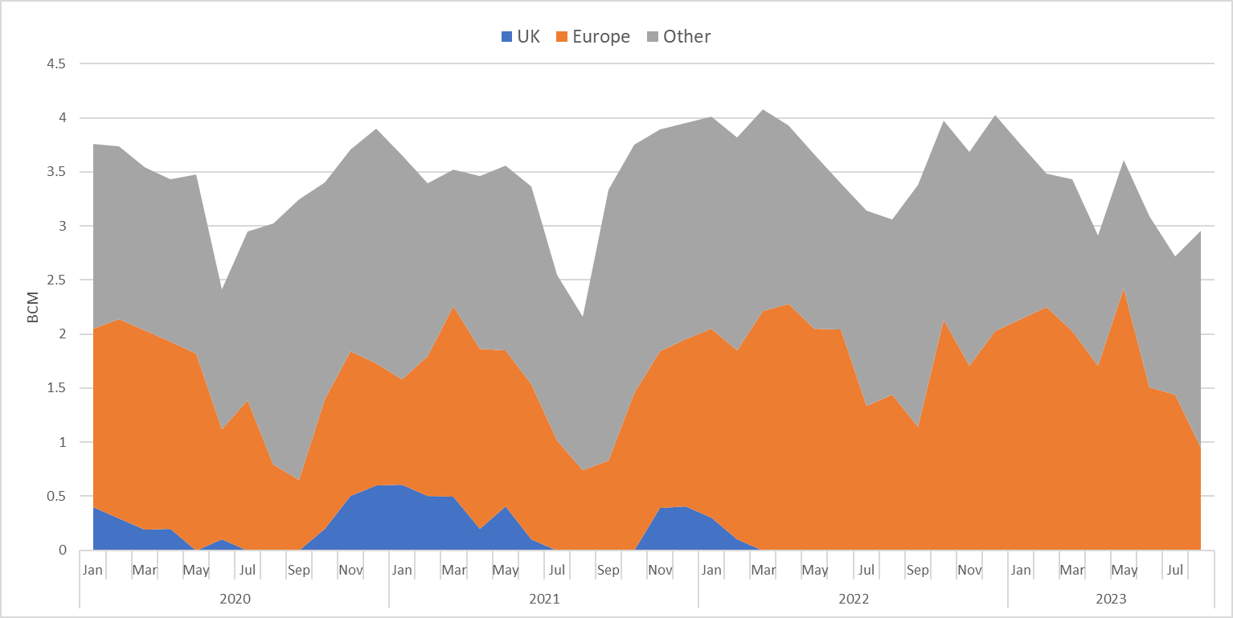
Russian gas supplies to Europe
Pipeline
LNG
Source: Refinitiv
Russian gas flows are still vulnerable

Slide 6
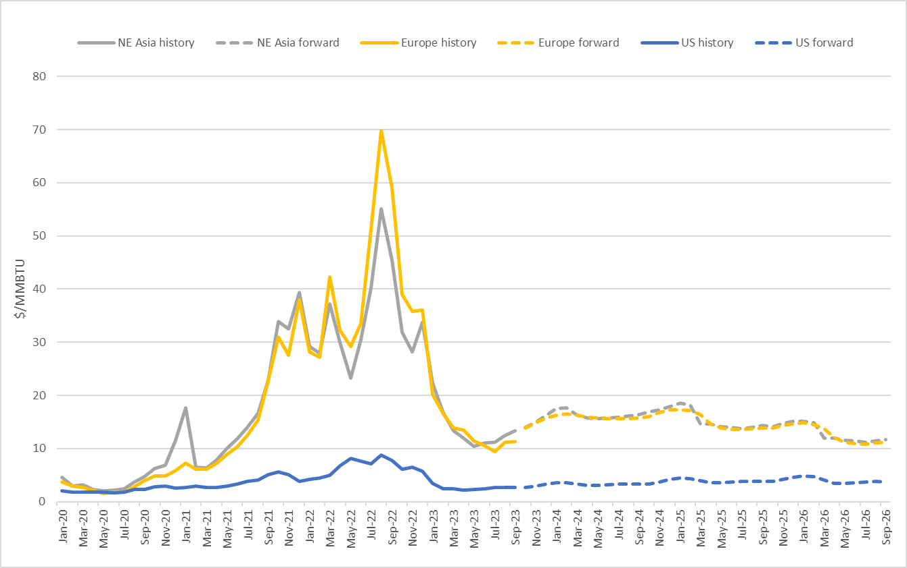
Global gas forward curves
Source: Refinitiv
LNG price spreads imply stability in the global balance

Slide 7
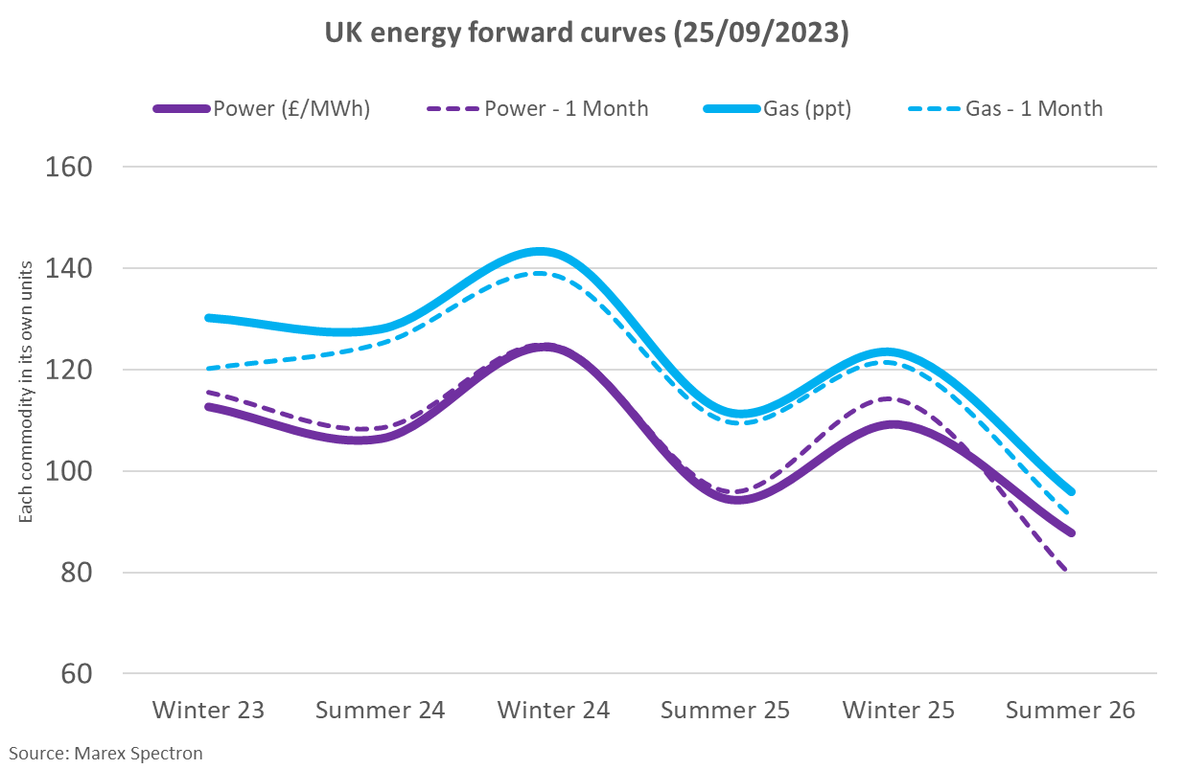
The UK Forward Curve
Risks remain and forward commodity prices are elevated in historic terms

Slide 8
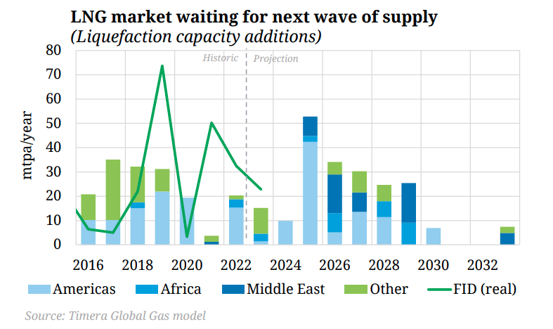
The UK Forward Curve: 2
150ppt
Global gas supplies set to increase again in 2025

Slide 9
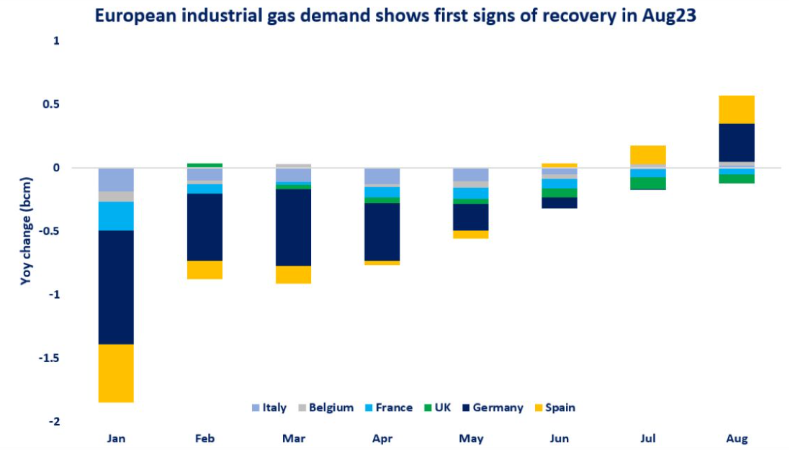
European demand destruction
Source: IEA

Slide 10
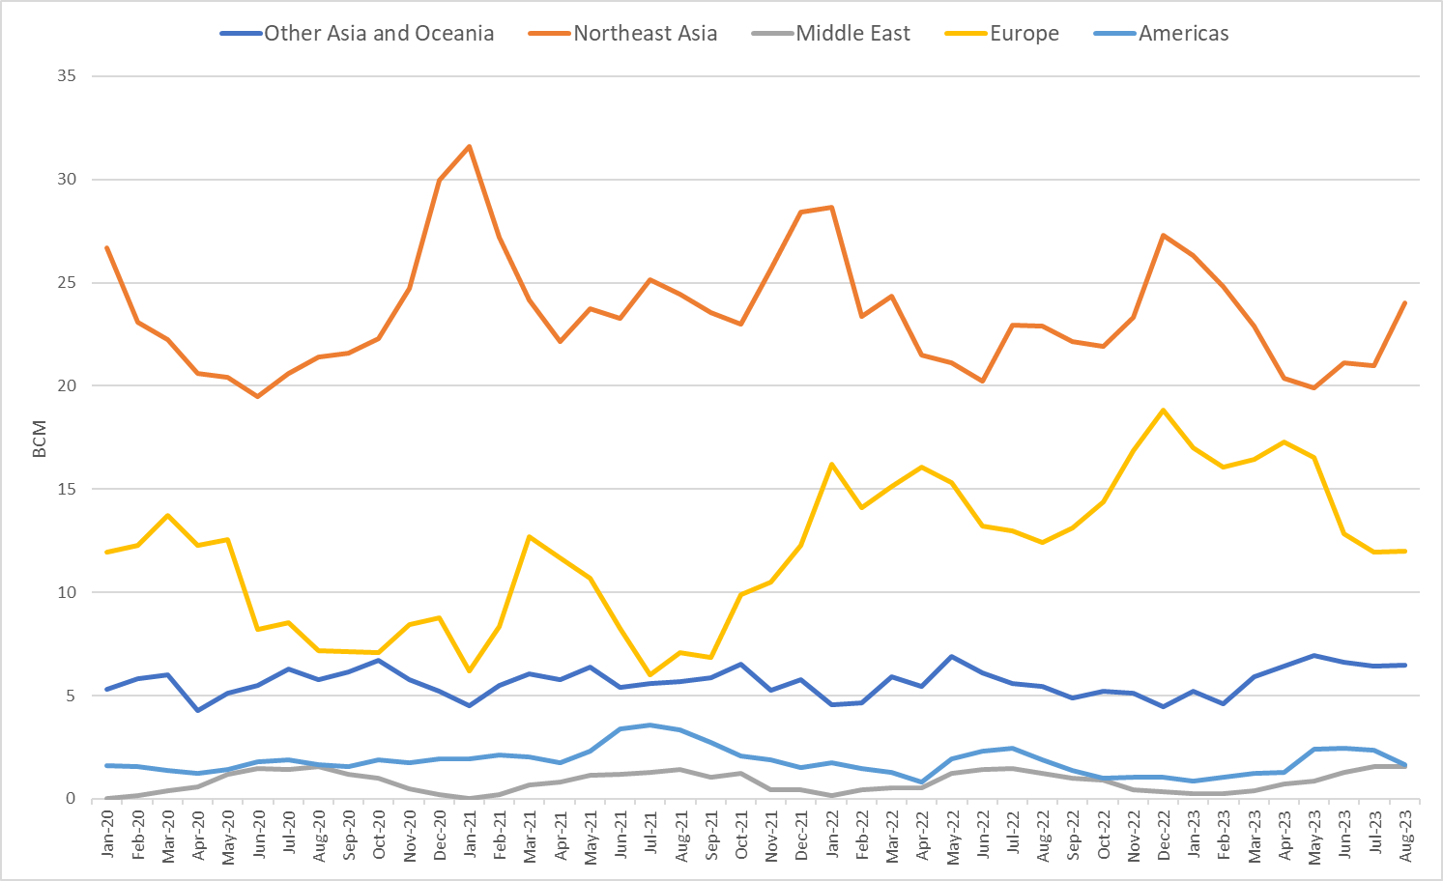
LNG demand in Asia
Source: Refinitiv
How much LNG will China require this winter?

Slide 11
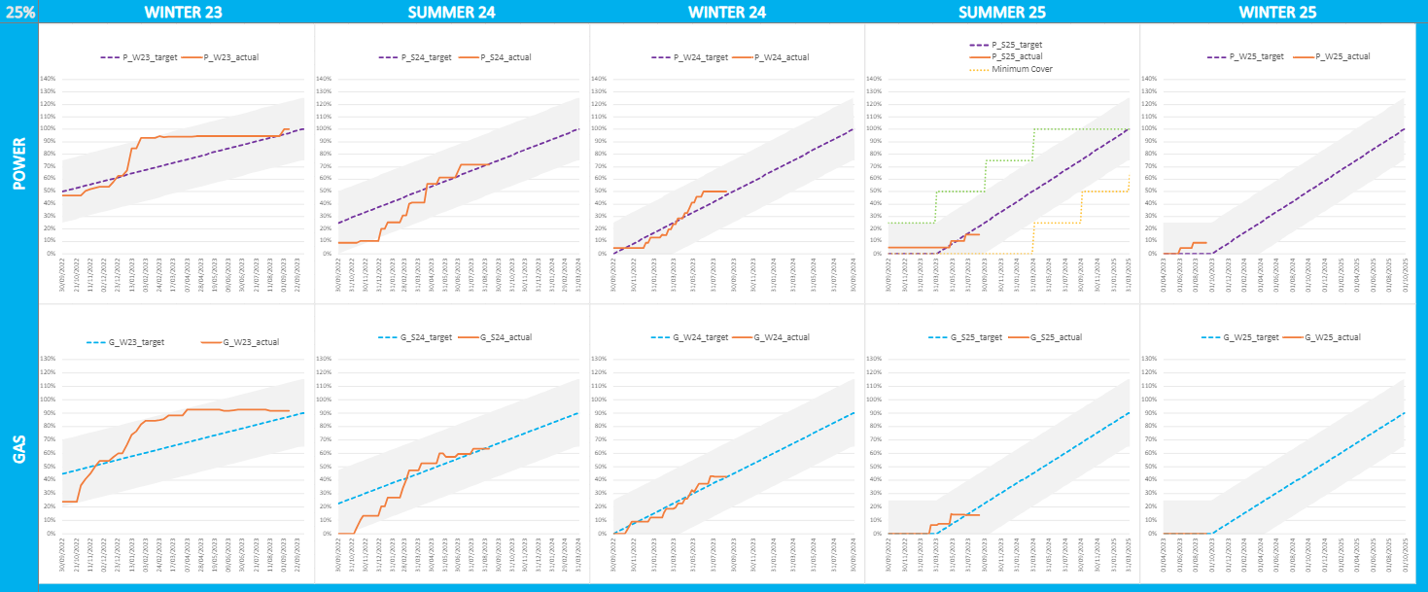
Contract cover

Slide 12
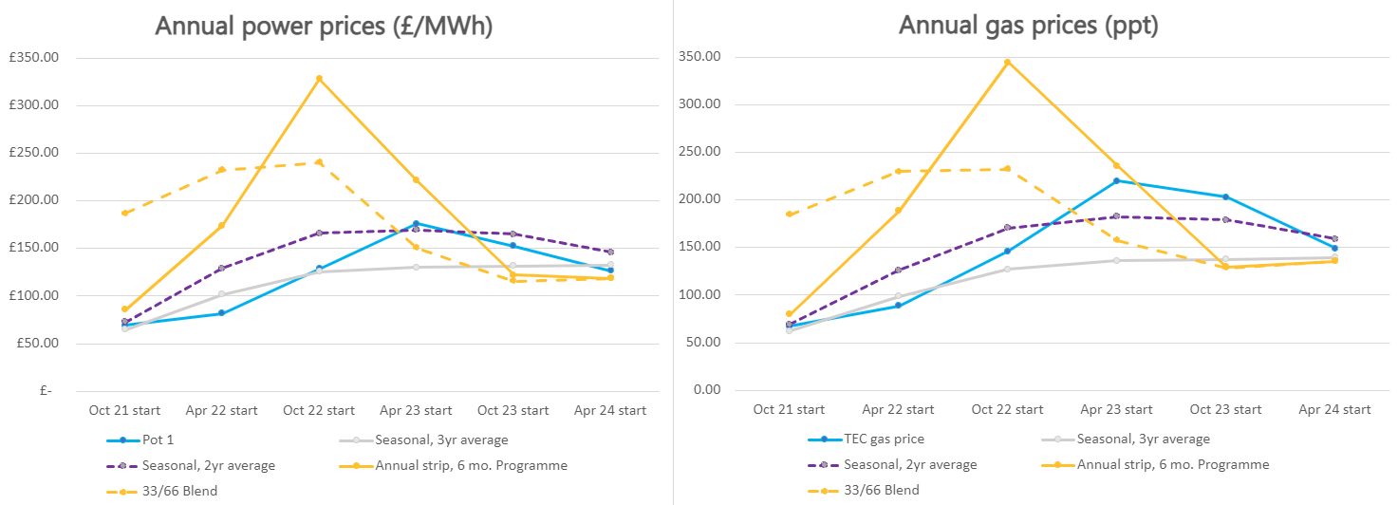
Cost of cover

